Slide 1
Towards Adaptive and Explainable Artificial Intelligence
Summary of CS294-131 Fa18 09/04/18 Talk
Trevor Darrell

Slide 2
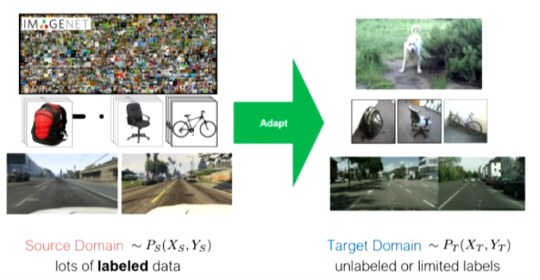
Part I: Domain Adaptation
Train on Source, Test on Target

Slide 3
Domain Adaptation Paradigms
Feature Augmentation-add training data transformed based on knowledge of domain.
Bootstrapping, a.k.a. “self-ensembling”, …- take high confidence predictions of source-only model and add them to training data, iterate…
Distribution alignment or transformation: domain adversarial learning / domain confusion using GAN-like models…
Notes:
1：但假定domain shift/variation是什么
2：risk of concept drift，一般用于不太远的
3：下面所讲的重点，Distribution alignment

Slide 4
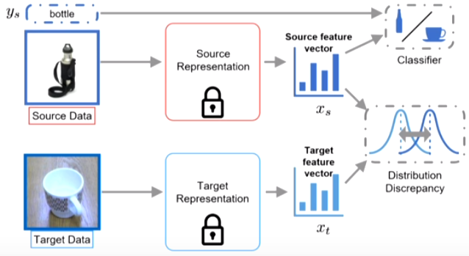
Classic Domain Adaptation
Notes:
上面部分： pre deep learning
但这样有问题，source、target分布不一样
我们需要domain的分布差异尽量没有
Learn a representation that cannot distinguish domains

Slide 5
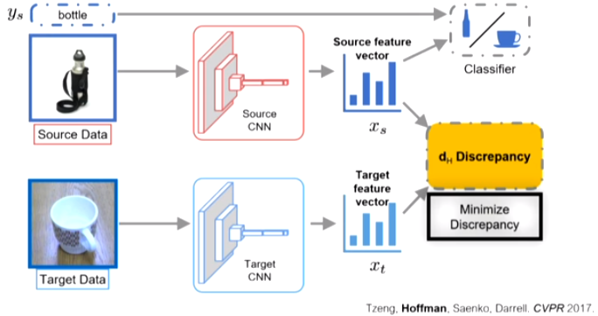
Deep Domain Adaptation
Notes:
黄色部分：Max mean discrepancy, higher order alignment等
即mean，或看更高阶，等
Dh有公式讲解，这里略去；即给出了target error的界，由source error、discrpancy等界定
但实际应用不确定这个界是否够紧，所以这里引出了一个更general的方法，即对抗

Slide 6
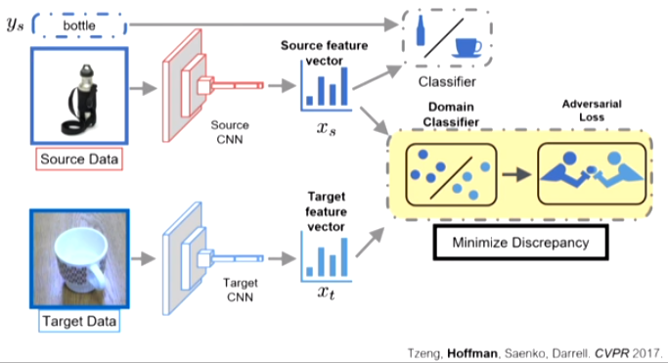
Adversarial Domain Adaptation
Notes:
注意，对抗中判别器要的label只是属于哪个domain的label

Slide 7
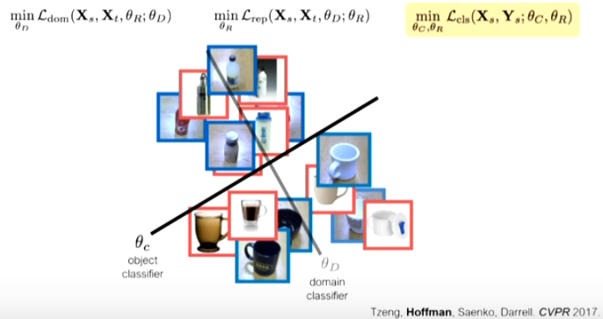

Slide 8
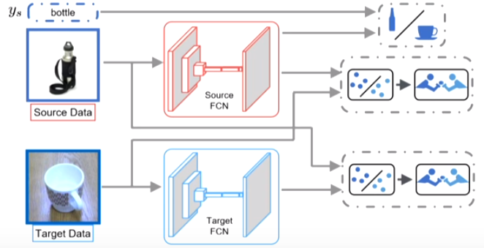
Pixel level+feature level

Slide 9
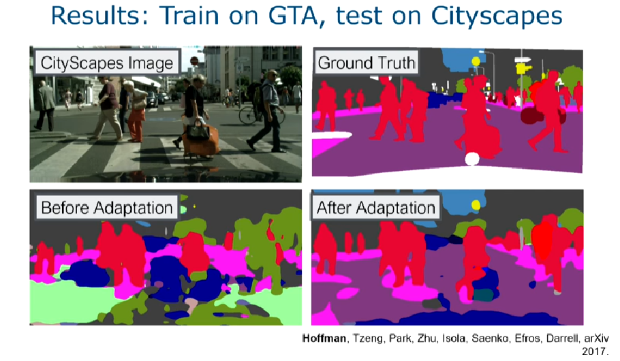
Notes:
一个实例

Slide 10
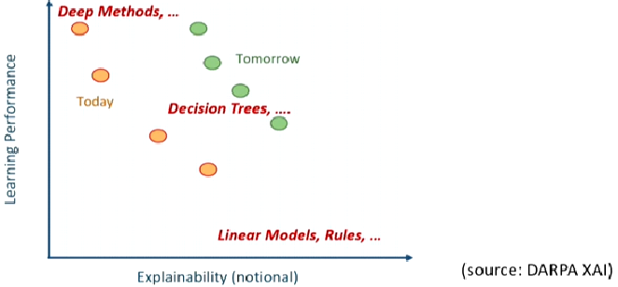
Part II: Explainable AI

Slide 11
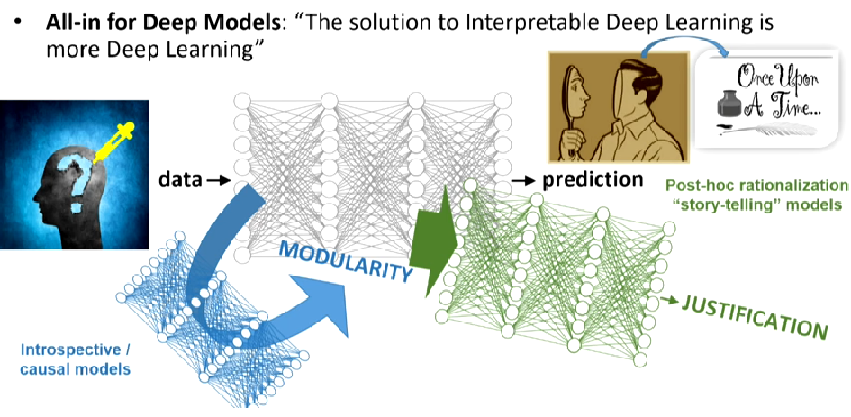
Modularity
Justification

Slide 12
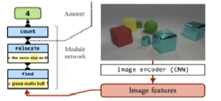
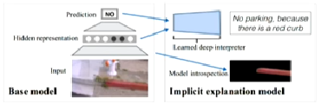
Deep Explanation Models
Explicit / Introspective models: interpretable interval visualization
Implicit /Justification models: post-hoc rationalization
Notes:
前者：内部可视化
后者：事后合理化

Slide 13
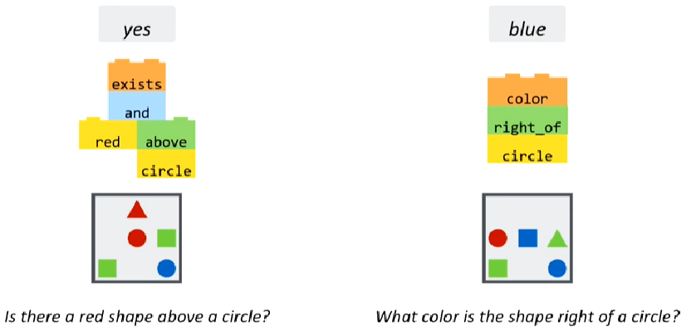
Modularity
Main reading: Learning to Reason: End-to-End Module Networks for Visual Question Answering

Slide 14
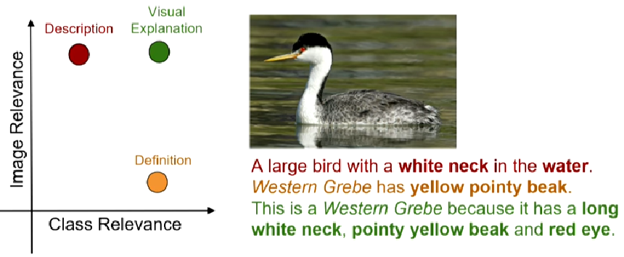
Justification
Notes:
从image caption说起；caption->explanation，和image有关也和task有关
Visual explanation，后面讲了几个工作，这里略去

Slide 15
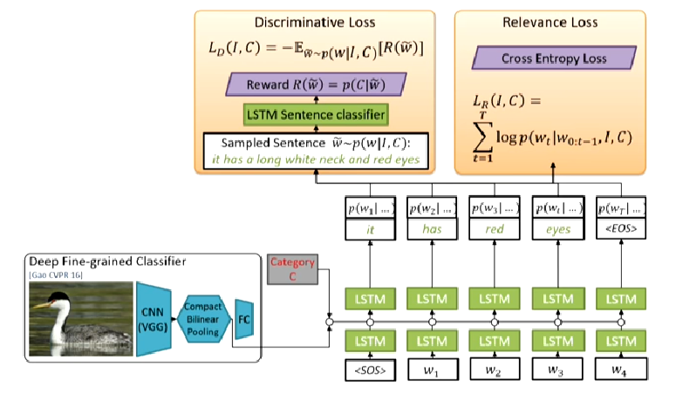
Visual explanation-training time
Notes:
一方面

Slide 16
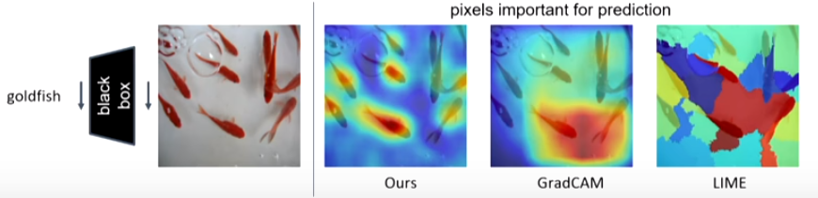
‘High-fidelity’ explanation
Notes:
另一方面
附录讲了一个工作，这里略去

Slide 17
Sumary of Papers

Slide 18
Task Definition
Visual Question Answer:
A VQA system takes an image as input and a free-form, open-ended, natural-language question about the image and produces a natural-language answer as the output.
Involved problems:
Natural Language Process
Object recognition
Multi-step reasoning
Explain-ability
Notes:
一个VQA系统以一张图片和一个关于这张图片形的自由、开放式的自然语言问题作为输入，以生成一条自然语言答案作为输出。简单来说，VQA就是依据给定的图片进行问答。

Slide 19
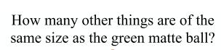
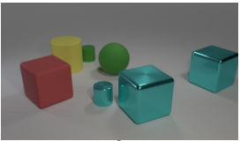

Slide 20
Learning to Compose Neural Networks for Question Answering
Jacob Andreas, Marcus Rohrbach, Trevor Darrell, Dan Klein

Slide 21
Motivation:
All of previous models assume that a fixed computation can be performed on the image and question to compute the answer, rather than adapting the structure of the computation to the question.
In this paper, we present a model for learning to select such structures from a set of automatically generated candidates. We call this model a dynamic neural module network.
Notes:
所有现有的VQA模型都假设可以对图像和问题执行固定计算以计算答案，而不是使计算结构适应问题。

Slide 22
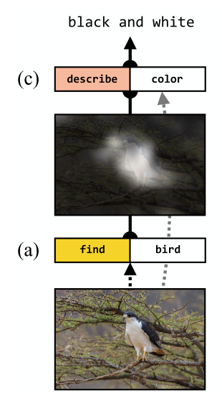
What color is the bird?

Slide 23
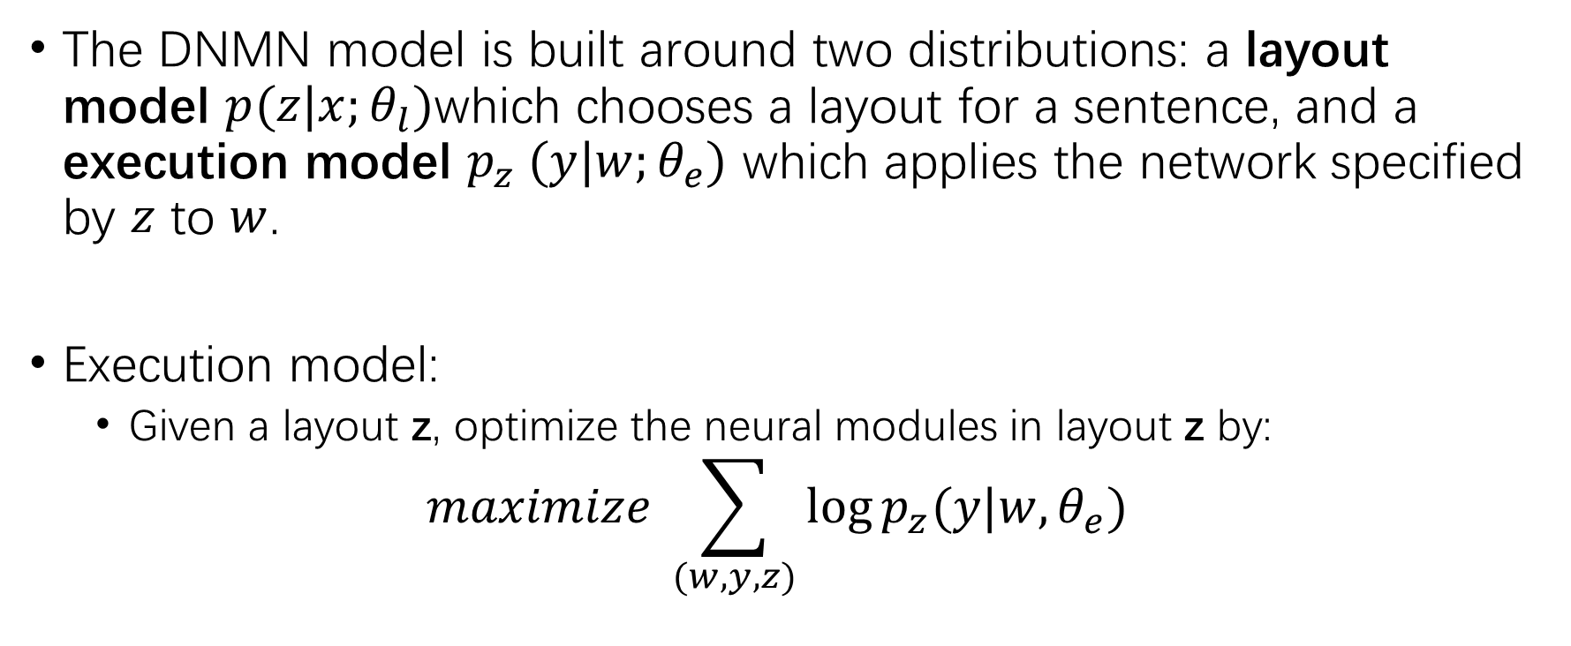
Model
The DNMN model is built around two distributions: a layout model $p(z|x;θ_{l})$which chooses a layout for a sentence, and a execution model $p_{z} (y|w;θ_{e})$ which applies the network specified by $z$ to $w$.
Execution model:
Given a layout z, optimize the neural modules in layout z by:
$$maximize \sum_{(w,y,z)}{\log{p_{z}(y|w, θ_{e})}}$$
Notes:
DNMN由2个模型构成，选择layout的l模型和执行对应layout计算的execution模型。
Z是layout, w是输入的图片或者是knowledges。
其中Execution模型在给定layout下以极大似然的方法优化模型

Slide 24
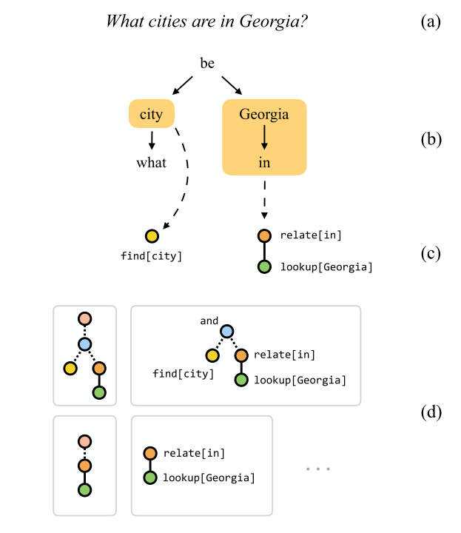
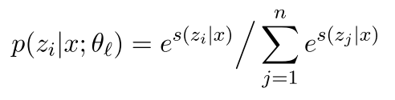
Layout model:
The modules used in this paper are shown below:
Lookup, Find, Relate, And, Describe, Exists
First use a fixed syntactic parse to generate a small set of candidate layouts in figure (d).
Then we need to score them. This is a ranking problem.
Notes:
Layout模型主要包括以下几种模块：
先由一个固定的parser生成得到一个layout候选集，再为各个layout打分，是一个排序问题

Slide 25
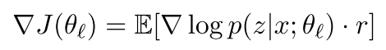
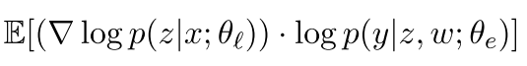
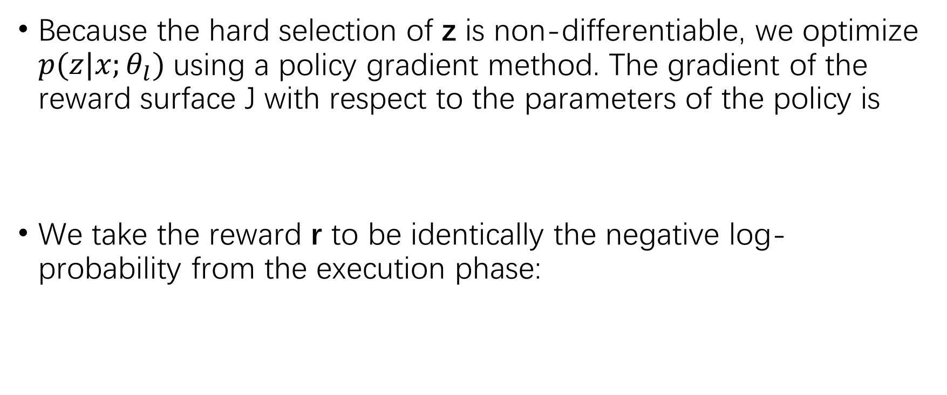
Jointly learning by RL
Because the hard selection of z is non-differentiable, we optimize $p(z|x;θ_{l})$using a policy gradient method. The gradient of the reward surface J with respect to the parameters of the policy is
We take the reward r to be identically the negative log-probability from the execution phase:
Notes:
因为对layout的选择是不可导的，采用policy gradient进行优化，reward是execution模型对该样本的似然

Slide 26
Learning to Reason: End-to-End Module Networks for Visual Question Answering
Ronghang Hu, Jacob Andreas, Marcus Rohrbach, Trevor Darrell, Kate Saenko

Slide 27
Motivation
Limitations of previous work:
Rely on an external parser.
None of the existing methods can learn to predict a suitable structure for every input in an end-to-end manner.
Our approach learns to optimize over the full space of network layouts rather than acting as a reranker, and requires no parser at evaluation time.
Notes:
先前的工作依赖于外部解析器来处理输入文本并获取模块布局。 这是一个严重的限制，因为现成的语言解析器不是为语言和视觉任务设计的，因此必须使用人工规则对于不能预测出合法layout的结果进行修改。
我们的方法能够学习在整个layout空间进行优化，并且不需要在测试时使用parser

Slide 28
Contributions
1) a method for learning a layout policy that dynamically predicts a network structure for each instance, without the aid of external linguistic resources at test time
2) a new module parameterization that uses a soft attention over question words rather than hard-coded word assignments
Notes:
提出了一个layout生成策略，不需要外部的语言资源。
提出了一个新的模块参数化方法，采用soft-attention的方法对输入的text进行不同时刻的特征提取，不但在生成下一时刻提供当前时刻下的attention信息，并且还要生成该时刻对问题的attention信息，作为生成各module的输入特征。

Slide 29
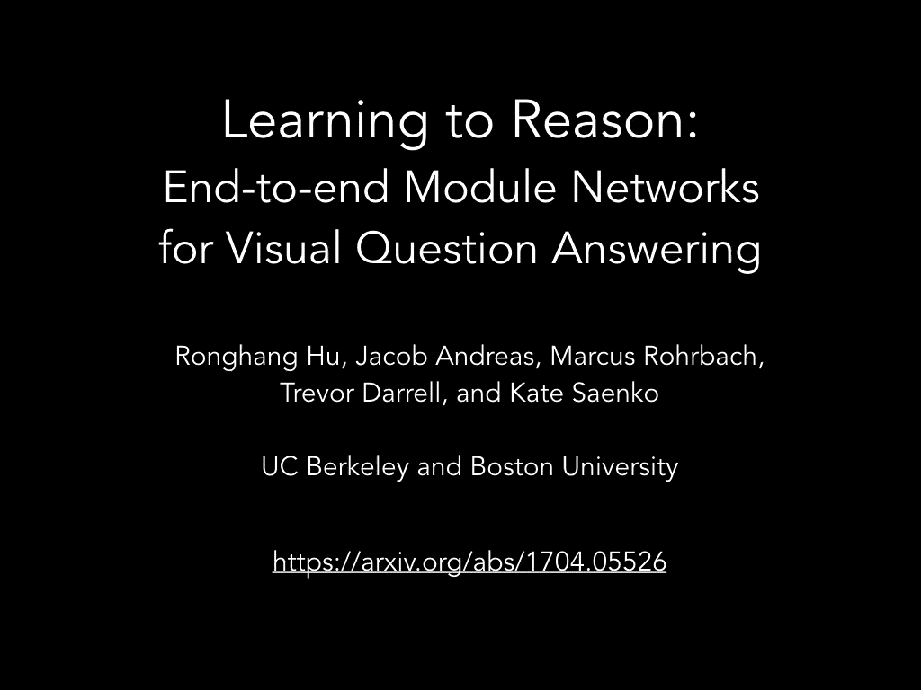

Slide 30
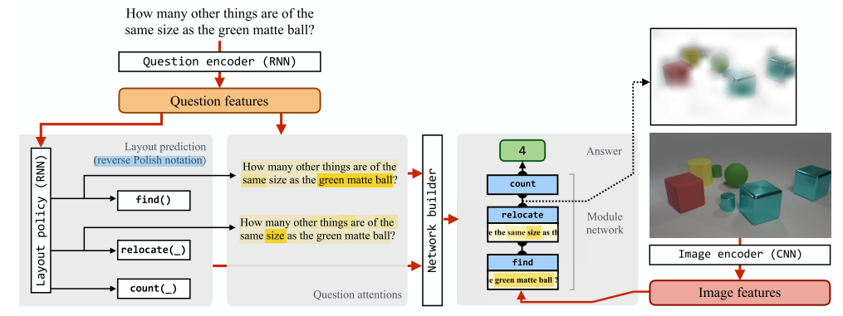
End-to-End Module Networks
Notes:
整个模型的结构如图，对于question，先由带attention的seq2seq生成出module序列，得到一个layout，以及各个module的文本输入特征x_{txt}，
对于Image，由CNN进行特征提取后X_{vis}，和生成的文本特征一同输入各module，解得最终的答案

Slide 31
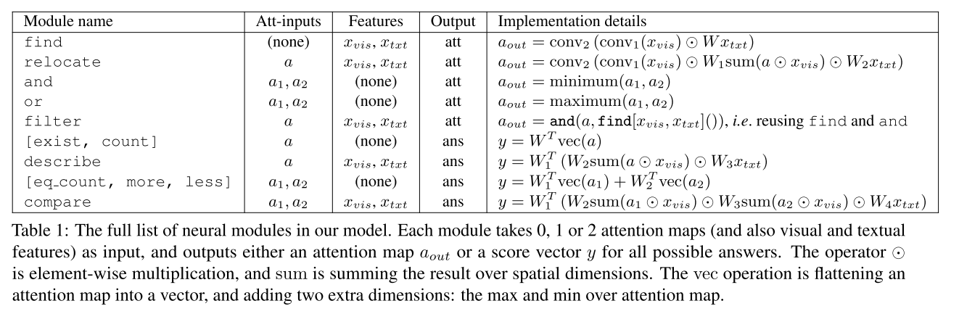
Notes:
其中module的定义以及实现细节如该表

Slide 32
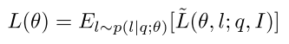
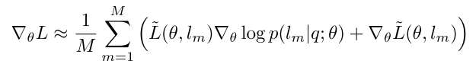
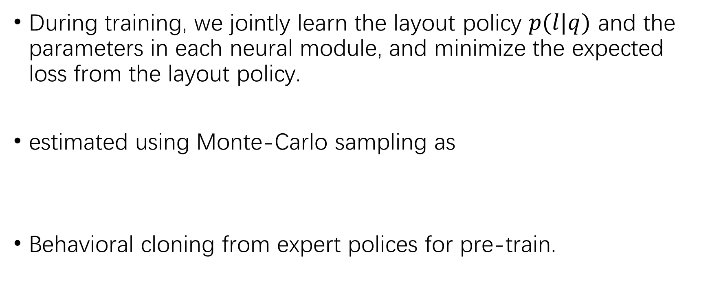
End-to-end training
During training, we jointly learn the layout policy $p(l|q)$ and the parameters in each neural module, and minimize the expected loss from the layout policy.
estimated using Monte-Carlo sampling as
Behavioral cloning from expert polices for pre-train.
Notes:
在训练过程中，为了优化期望损失，采用蒙特卡洛采样来进行近似。并使用了特定的parse作为专家策略对模型进行pretrain，相当于做了经验上的初始化。

Slide 33
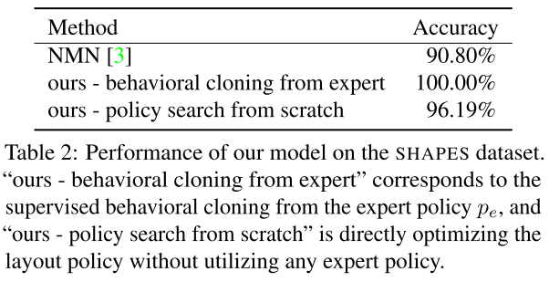
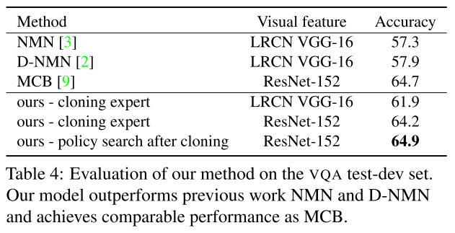
Experiments
Notes:
在shape数据集上，已经能够100%正确回答问题了，在VQA数据集上，比比赛期间的第一名MCB还高出0.2

Slide 34
Conclusions
Commons:
Dynamic structure.
Break down the main task.
Advantages:
Smaller space in subtask.
Better explanation.
Future work:
How to solve the more general question?

Slide 35
Discussion
How about the similar methods on other task?
eg. Math Problem, Question Answer, Conversation ...

